Slide 1
Image Processing INT3404 20
Lecturer: Nguyen Thi Ngoc Diep, Ph.D.
Email: ngocdiep@vnu.edu.vn
Notes:
7 13h00’  13h50’ 10’
8 14h00’  14h50’ 10’
9 15h00’  15h50’

Slide 2
Schedule
Tuần | Nội dung | Yêu cầu đối với sinh viên (ngoài việc đọc tài liệu tham khảo)
1 | Giới thiệu môn học | Cài đặt môi trường: Python 3, OpenCV 3, Numpy, Jupyter Notebook
2 | Ảnh số (Digital image) – Phép toán điểm (Point operations) Làm quen với OpenCV + Python
3 | Điều chỉnh độ tương phản (Contrast adjust)– Ghép ảnh (Combining images) | Làm bài tập 1: điều chỉnh gamma tìm contrast hợp lý
4 | Histogram - Histogram equalization | Thực hành ở nhà
5 | Phép lọc trong không gian điểm ảnh (linear processing filtering) | Thực hành ở nhà
6 | Thực hành: Ứng dụng của histogram; Tìm ảnh mẫu (Template matching) | Bài tập mid-term
7 | Trích rút đặc trưng của ảnh Cạnh (Edge) và đường (Line) và texture | Thực hành ở nhà
8 | Các phép biến đổi hình thái (Morphological operations) | Làm bài tập 2: tìm barcode
9 | Chuyển đổi không gian – Miền tần số – Phép lọc trên miền tần số Thông báo liên quan đồ án môn học | Đăng ký thực hiện đồ án môn học
10 | Xử lý ảnh màu (Color digital image) | Làm bài tập 3: Chuyển đổi mô hình màu và thực hiện phân vùng
11 | Các phép biến đổi hình học (Geometric transformations) | Thực hành ở nhà
12 | Nhiễu – Mô hình nhiễu – Khôi phục ảnh (Noise and restoration) | Thực hành ở nhà
13 | Nén ảnh (Compression) | Thực hành ở nhà
14 | Hướng dẫn thực hiện đồ án môn học | Trình bày đồ án môn học
15 | Hướng dẫn thực hiện đồ án môn học Tổng kết cuối kỳ | Trình bày đồ án môn học

Slide 3
Recall week 1
Three main levels in image processing
Low level:
Input:: image → Output:: image
Objective: Change the values of pixels
Middle level:
Input:: image → Output:: features or regions of interest (ROI)
Objective: Extract information from image
High level:
Input:: image → Output:: description, evaluation
Objective: Recognize objects, characteristics; describe the information of the image
Topics in this class

Slide 4
Week 2: Digital image fundamentals
Digital image
Point operations

Slide 5
Human visual perception
Why study visual perception?
Image processing algorithms are designed based on how our visual system works
In image compression, we need to know what information is not perceptually important and can be ignored
In image enhancement, we need to know what types of operations that are likely to improve an image visually

Slide 6
The human visual system
The human visual system consists of two primary components – the eye and the brain, which are connected by the optic nerve
Eye: receiving sensor (~ camera, scanner)
Brain: information processing unit ( ~ computer system)
Optic nerve: connection cable (~ physical wire)

Slide 7
How visual system works
1
Light energy is focused by the lens of the eye into sensors and retina
The sensors respond to the light by an electrochemical reaction that sends an electrical signal to the brain (through the optic nerve)
The brain uses the signals to create neurological patterns that we perceive as images
3
2
1
2
3
Source: https://www.brainhq.com/brain-resources/cool-brain-facts-myths/how-vision-works

Slide 8
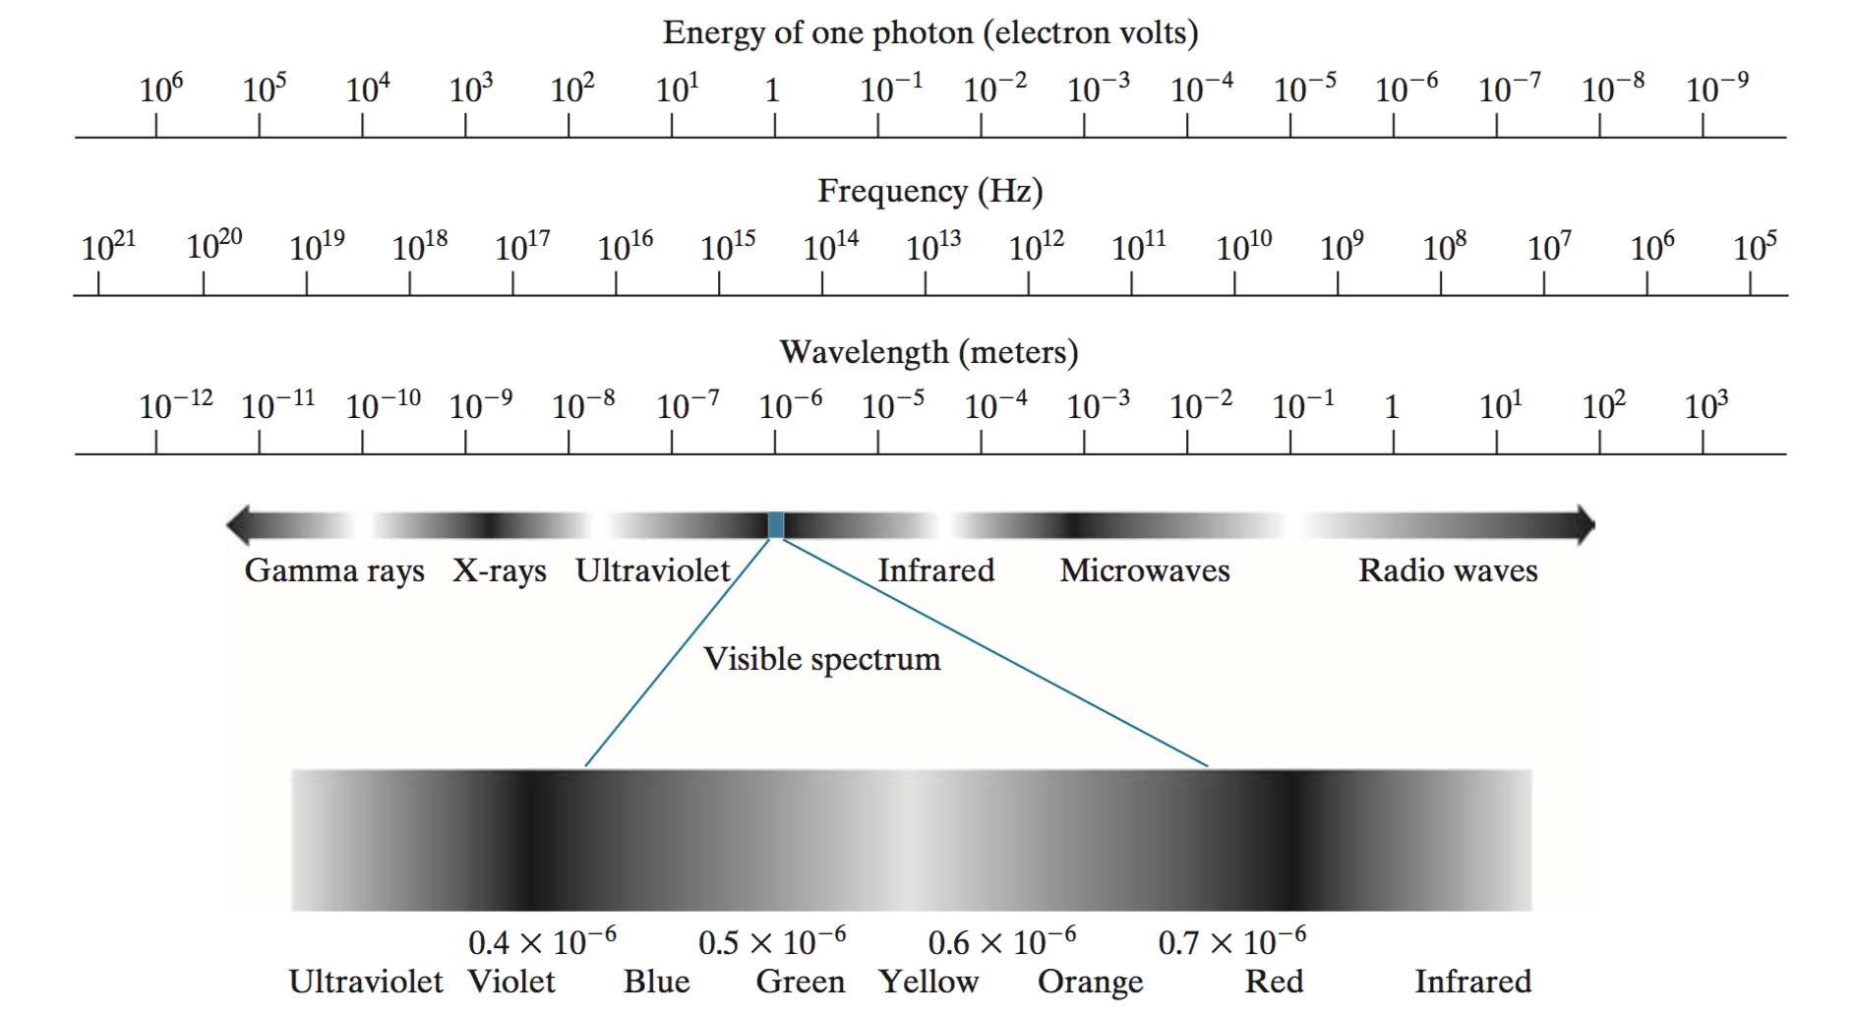
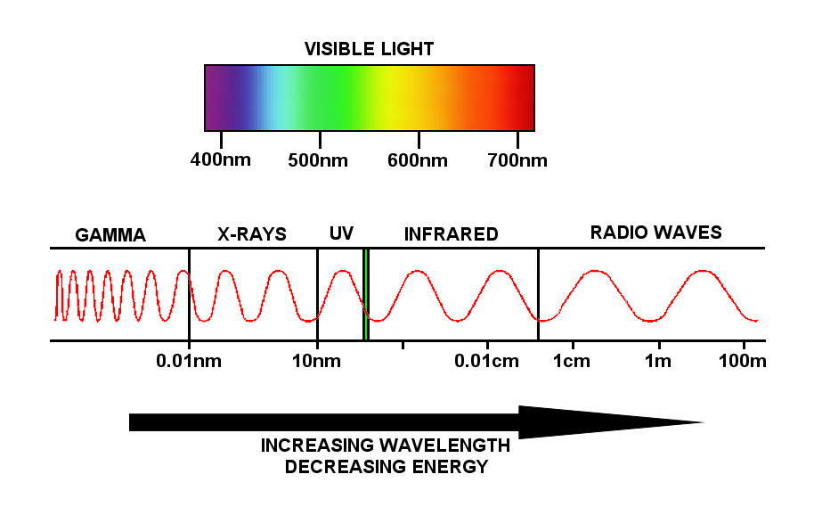
Electromagnetic spectrum & visible spectrum

Slide 9
Grayscale: black – gray – white
Ref: https://www.colormatters.com/color-and-design/are-black-and-white-colors
Notes:
https://www.quora.com/How-do-we-perceive-the-color-grey

Slide 10
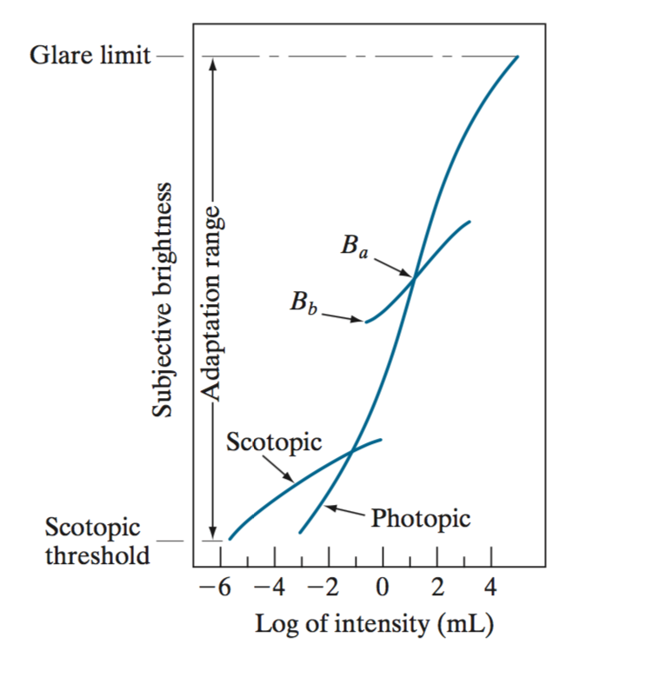
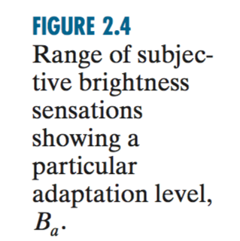
Brightness adaptation and discrimination
The range of light intensity levels to which the HVS can adapt is enormous – on the order of 10^10
However, HVS cannot operate over such a range simultaneously
Brightness adaptation: changing overall sensitivity when perceiving light intensity
At a given light intensity level, HVS can only discriminate between changes of a smaller range

Slide 11
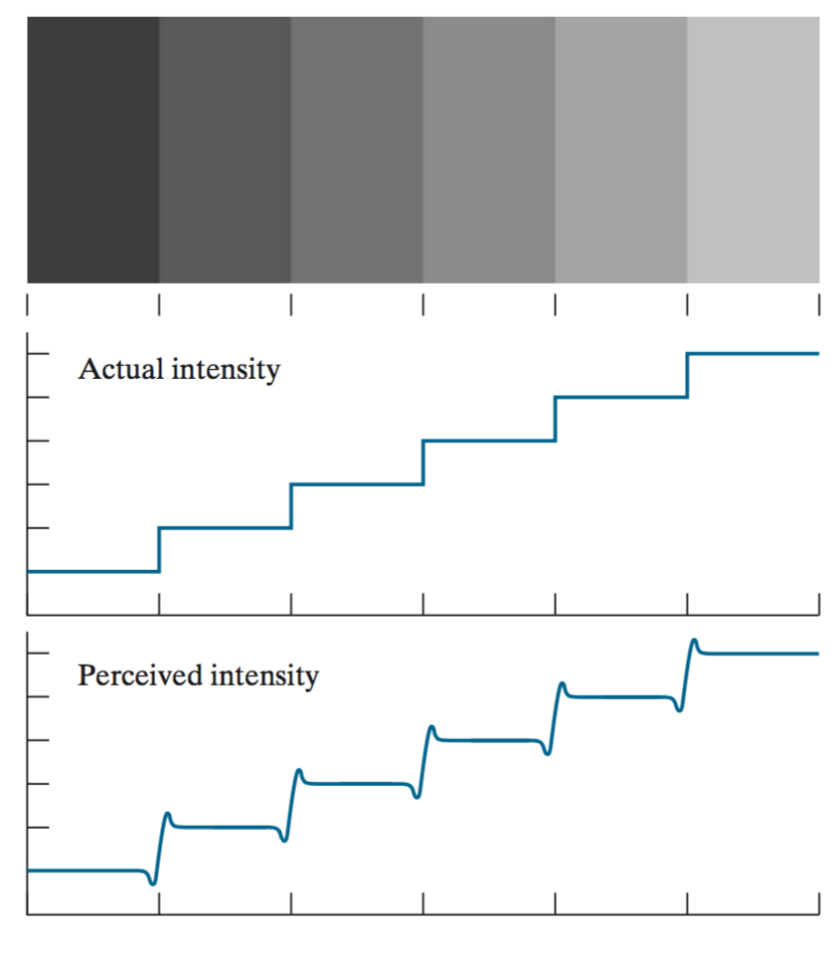
Mach band effect
Perceived brightness is not a simple function of intensity
HVS tends to undershoot or overshoot around the boundary of regions of different intensities
Source: Fig. 2.7, Gonzalez

Slide 12
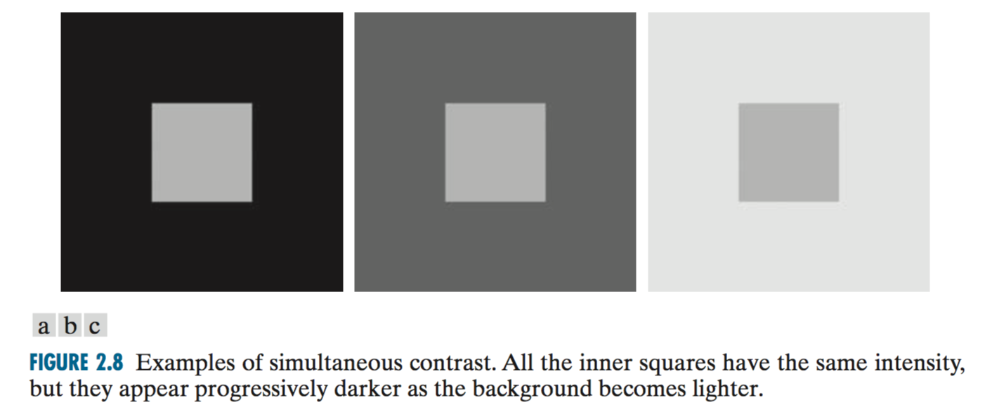
Simultaneous contrast
A region’s perceived brightness does not depend only on its intensity

Slide 13
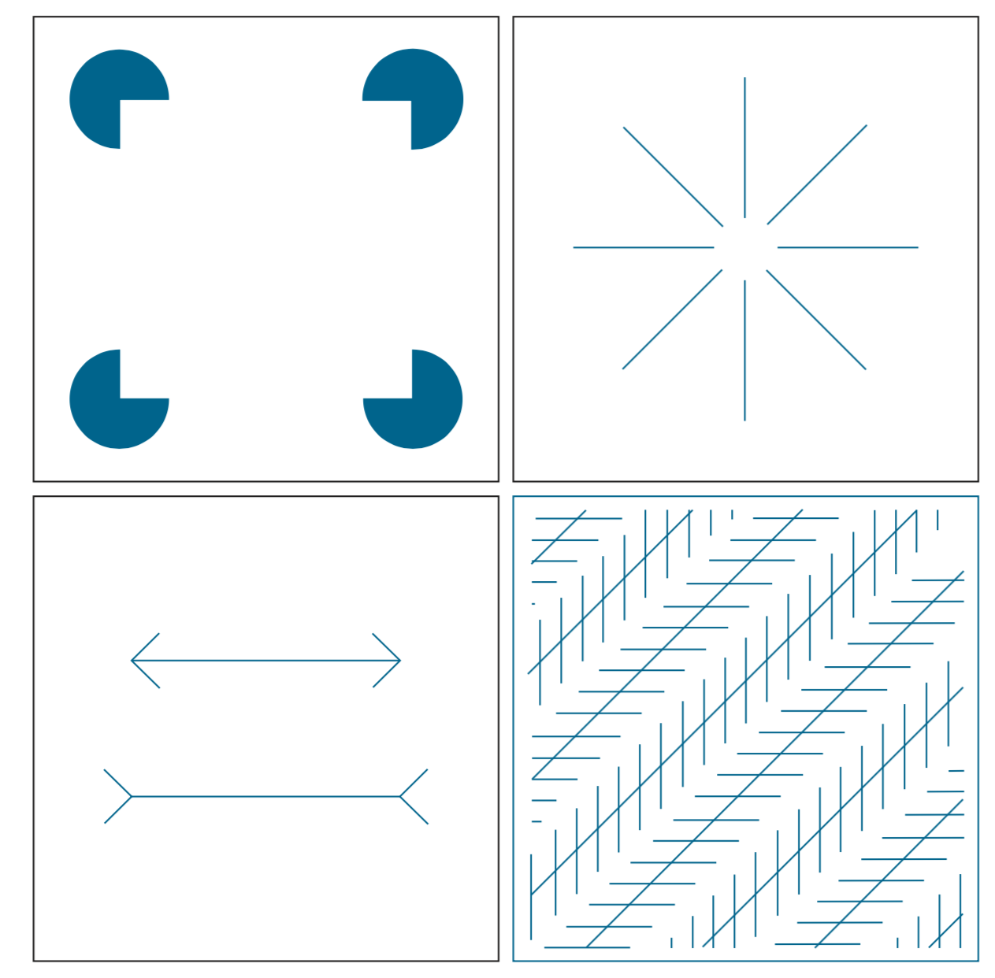
Some optical illusions
Outline of a square is seen clearly, despite the fact that no lines defining such a figure.
Outline of a circle
All long lines are equidistant and parallel, yet, the crosshatching creates the illusion that those lines are far from being parallel
Two horizontal line segments are of the same length, but one appears shorter than the other.
Source: Fig. 2.9, Gonzalez

Slide 14
Digital image

Slide 15
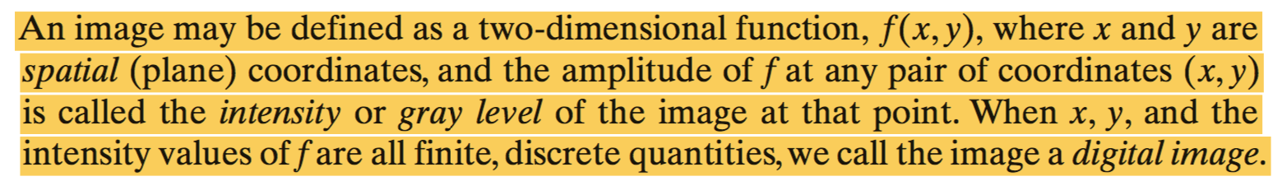
Definition of “digital image”
Value of f at (x, y) : picture element, image element, pel, or pixel
Nonnegative and finite
A scalar quantity whose physical meaning is determined by the source of the image, and whose values are proportional to energy radiated by a physical source

Slide 16
Image acquisition: generate digital images from sensed data
Note: There are numerous ways to acquire images
For examples:
Sensor arrays (e.g., CCD)
Sensor strips (e.g., X-ray, CAT, PET, MRI...)
Notes:
CCD: Charge-coupled Device
CAT: computerized axial tomography imaging
MRI: Magnetic resonance imaging
PET: positron emission tomography

Slide 17
Image sampling and quantization
To digitize function f(x,y), we have to sample the function in both coordinates and amplitude.
Sampling: digitizing the coordinate values
Quantization: digitizing the amplitude values
Continuous image
A scan line AB

Slide 18
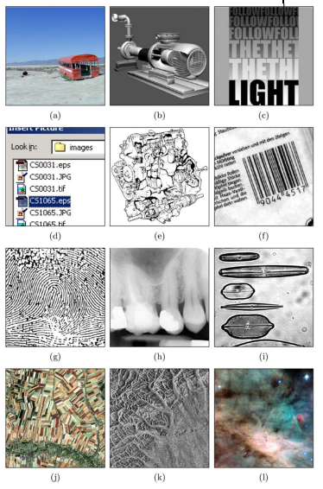
Examples of Digital images
Natural landscape
Synthetically generated scene
Poster graphic
Computer screenshot
Black and white illustration
Barcode
Fingerprint
X‐ray
Microscope slide
Satellite Image
Radar image
Astronomical object
Note: although imaging is based predominantly on energy from electromagnetic wave radiation, this is not the only method for generating images.
Others: sound -> ultrasonic images, software -> synthetic images
Ref: https://web.cs.wpi.edu/~emmanuel/courses/cs545/S14/slides/lecture01.pdf

Slide 19
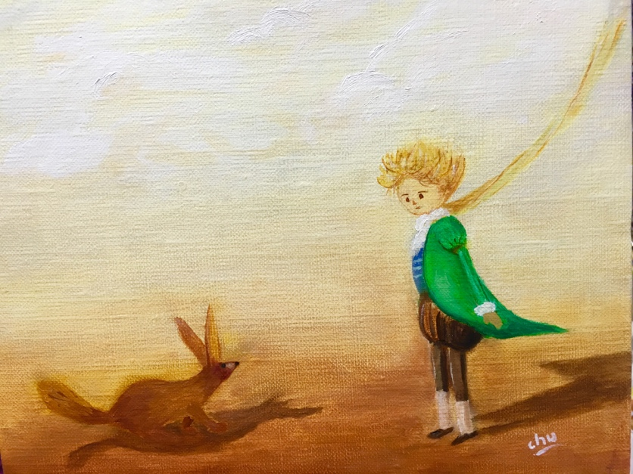
Digital image example (1/4)
Photo of painting
Graphical image

Slide 20
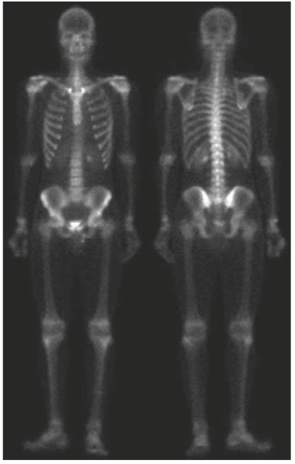
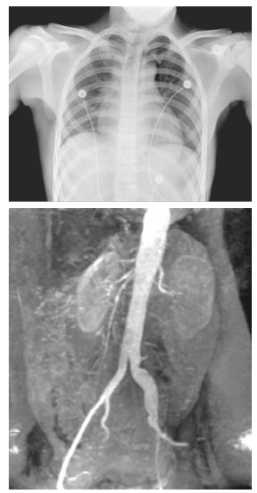
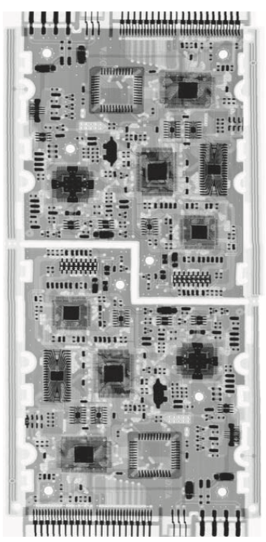
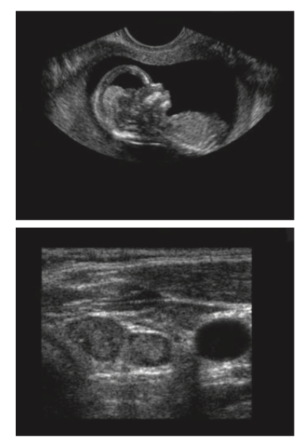
Digital image example (2/4)
gamma
X-ray
ultrasound

Slide 21
Digital image example (3/4)

Slide 22
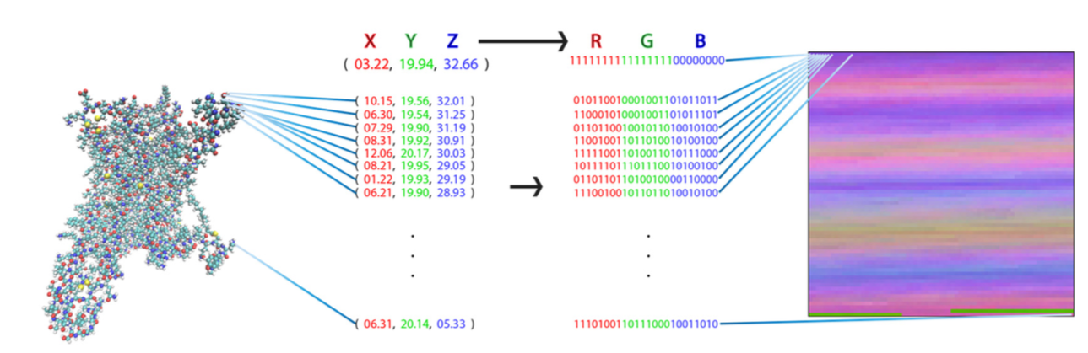
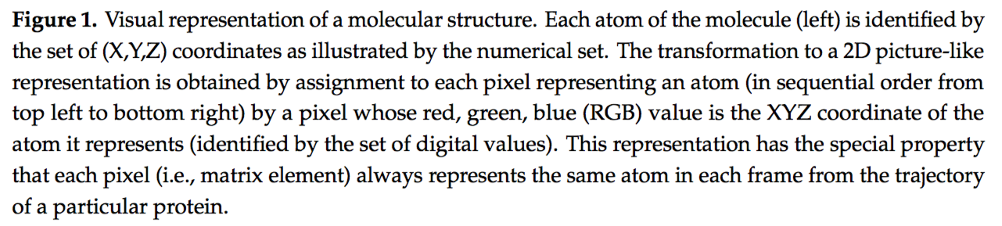
Digital image example (4/4)
Plante, Ambrose, et al. "A Machine Learning Approach for the Discovery of Ligand-Specific Functional Mechanisms of GPCRs." Molecules 24.11 (2019): 2097.

Slide 23
Image representation

Slide 24
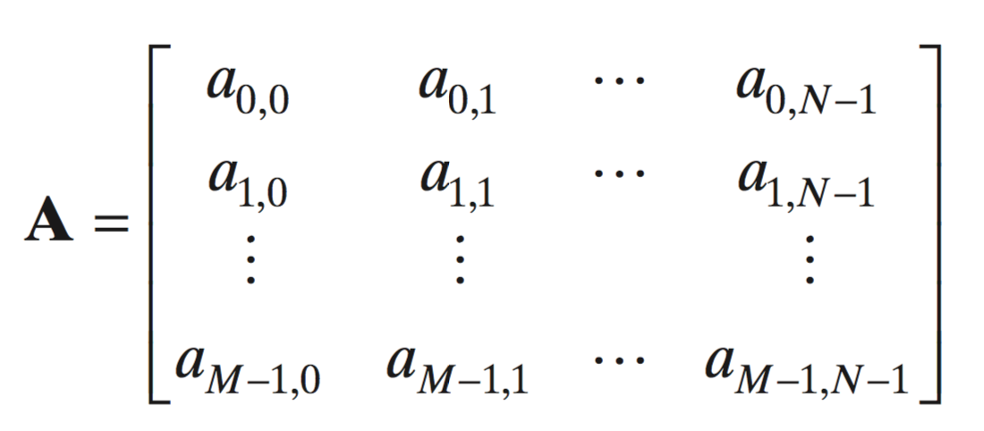
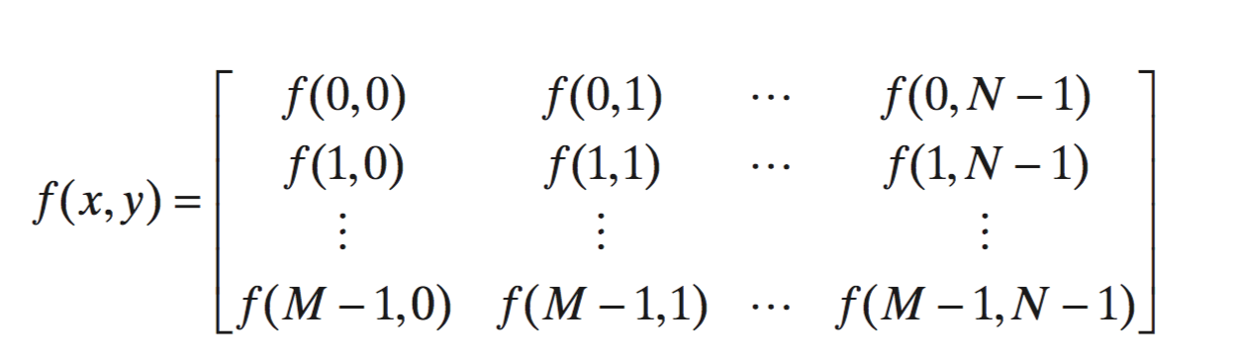
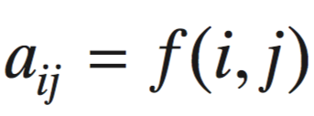
Representing digital images
f(x,y) containing M rows and N columns, where (x,y) are discrete coordinates
Image origin: f(0,0)
f(x,y) as an M x N numerical array or a 2D matrix

Slide 25
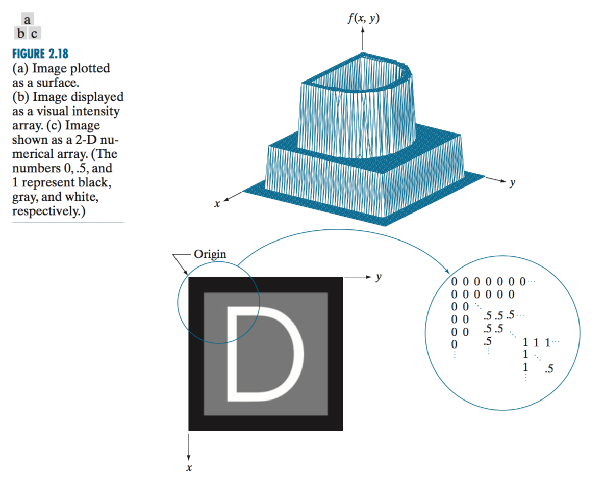
Representing images - plotting

Slide 26
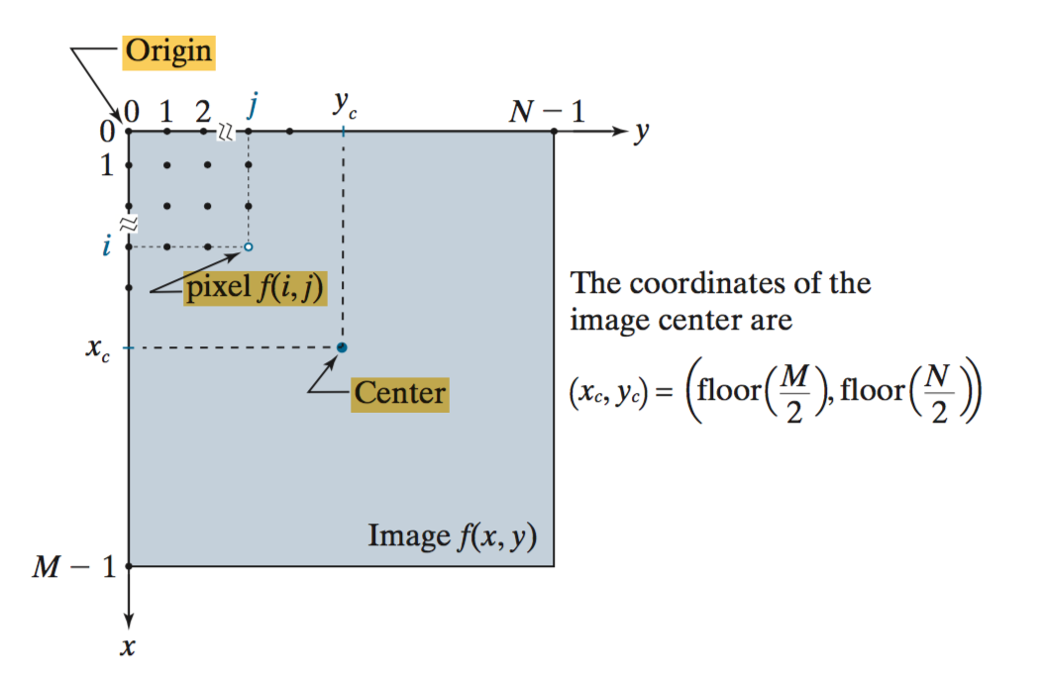
Image coordinate

Slide 27
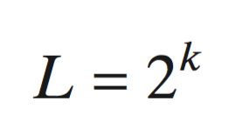
Image digitization
Image digitization requires that decisions be made regarding the values for M, N, and for the number, L, of discrete intensity levels
M, N: positive integers
L: depends on digital storage, and quantizing hardware considerations
K=8 →L=256
Contrast ratio = ratio of the highest and lowest intensity levels in an image

Slide 28
Quantization levels
Conventional grayscale image has 256 levels
Image credit: Bernd Girod

Slide 29
Effects of varying number of intensity levels
Appear “false contouring”

Slide 30
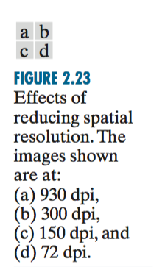
Spatial resolution
Spatial resolution: a measure of the smallest discernible detail in an image
Measurement:
“line pairs per unit distance”,
“dot (pixels) per unit distance”

Slide 31
Point operations

Slide 32
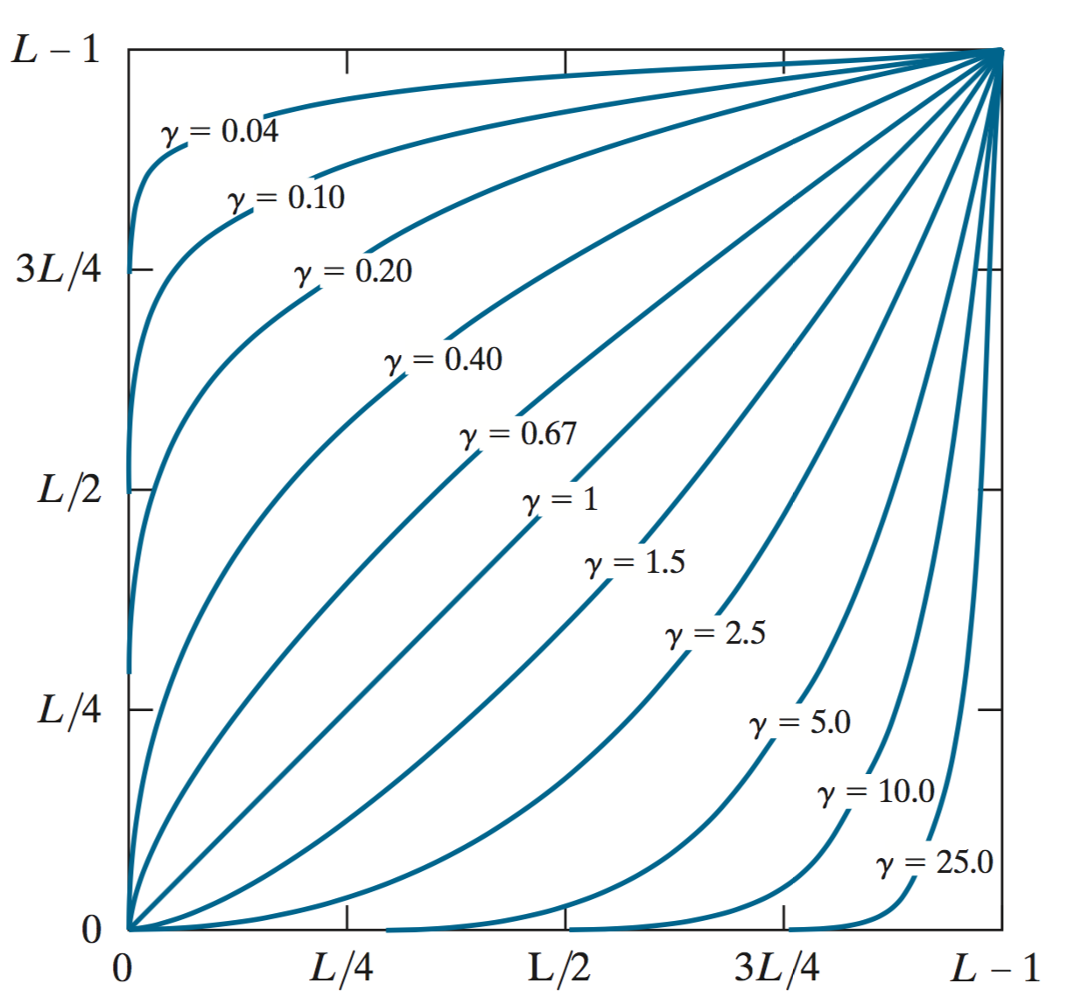
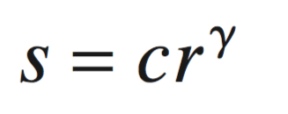
Power-law (Gamma) transformations
Output intensity levels, s
- With fractional values of gamma, power-law curves map a narrow range of dark input values into a wider range of output values
- The opposite being true for higher values of input levels
Input intensity levels, r
Gonzalez et. al. (fig. 3.6)

Slide 33
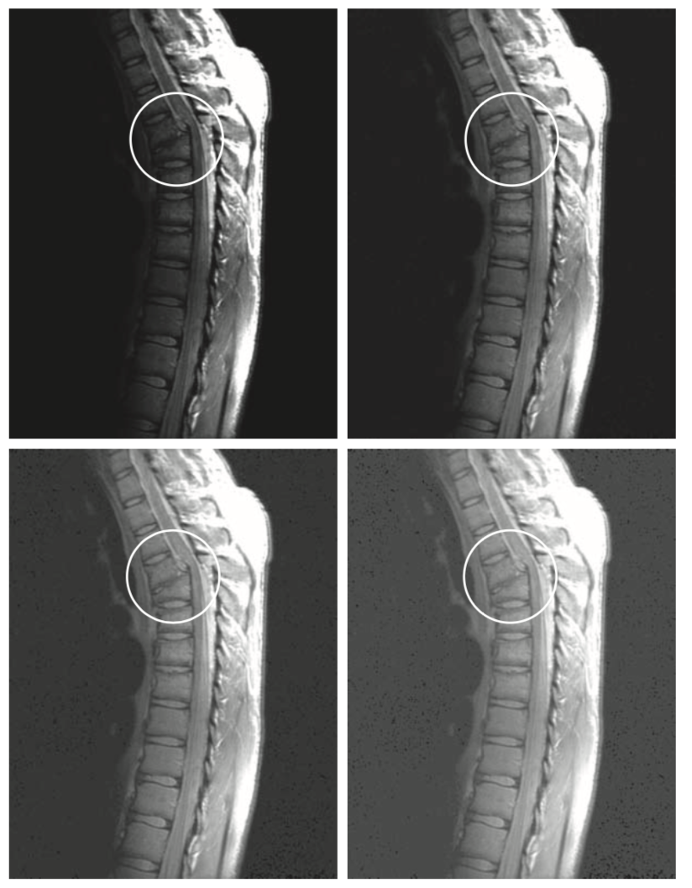
Gamma transformation
Gamma decreased from 0.6 to 0.4: more detail became visible
A further decrease of gamma to 0.3 enhanced a little more detail in the background, but began to reduce contrast, the image started to have a very slight “washed-out” appearance
gamma = 0.6
gamma = 0.4
gamma = 0.3
Gonzalez et. al. (fig. 3.8)

Slide 34
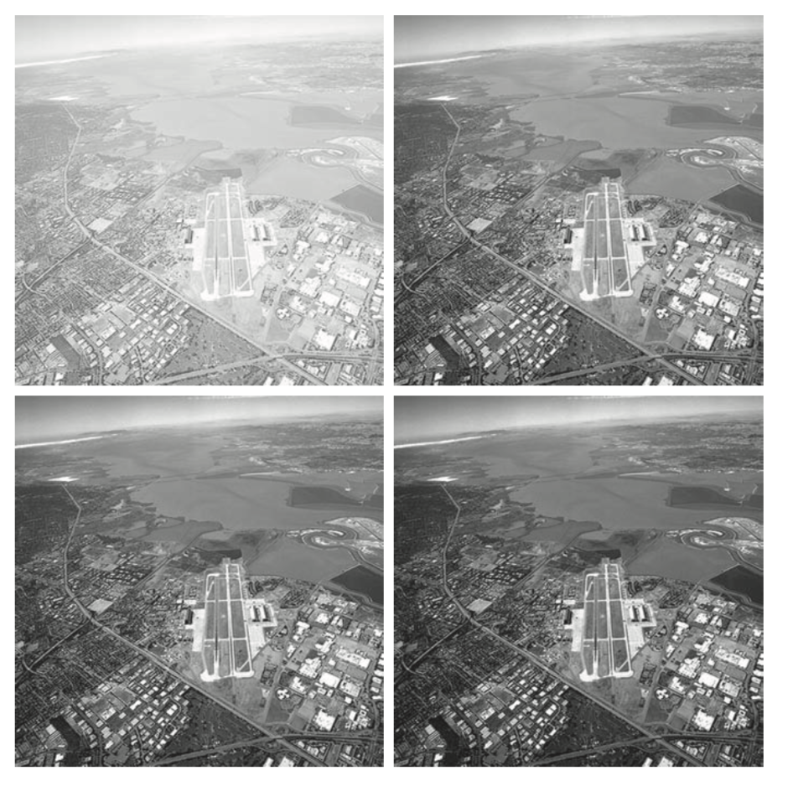
Gamma transformation
Low contrast is enhanced by gamma > 1
gamma = 3.0
gamma = 4.0
gamma = 5.0
Gonzalez et. al. (fig. 3.9)

Slide 35
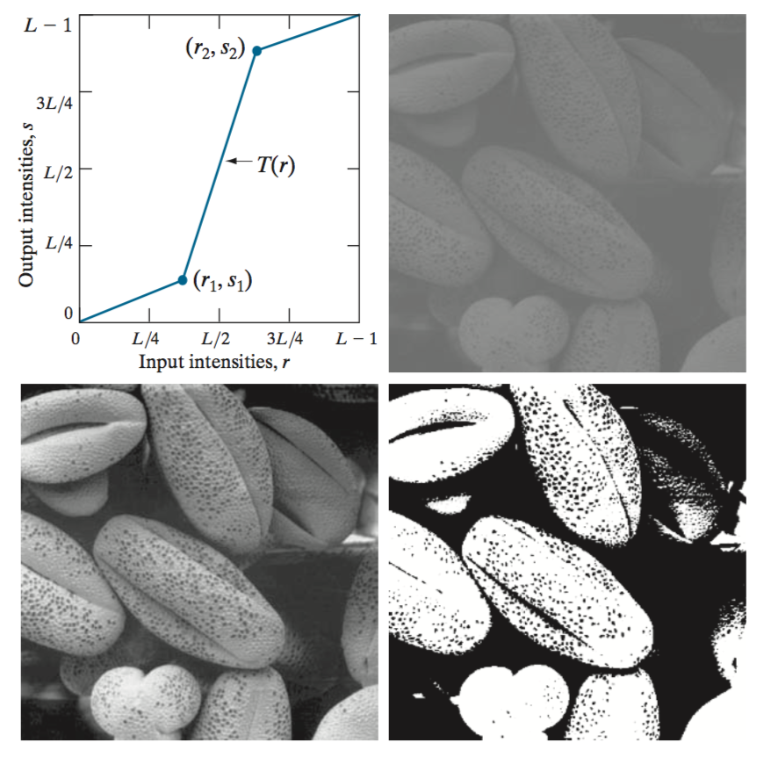
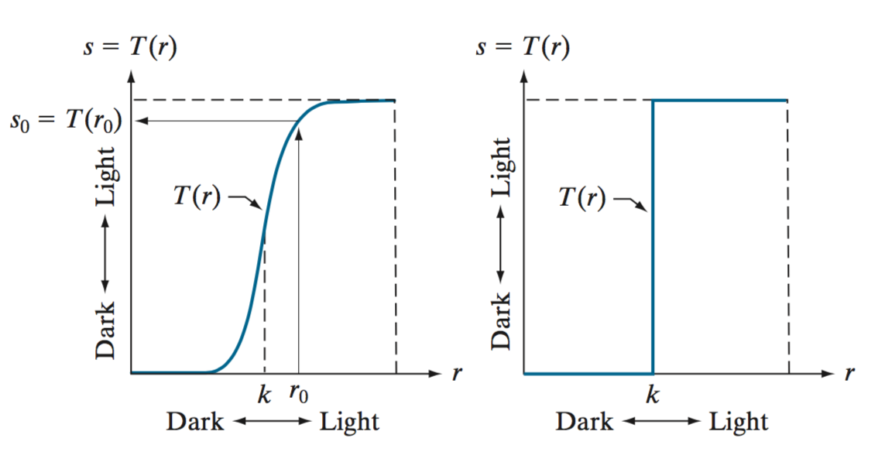
Thresholding
Example:

Slide 36
Piecewise linear transformation Contrast stretching
Gonzalez et. al. (fig. 3.10)

Slide 37
Image negatives
out = L – 1 – in
for example: out = 256 - 1 - in

Slide 38
Arithmetic operations

Slide 39
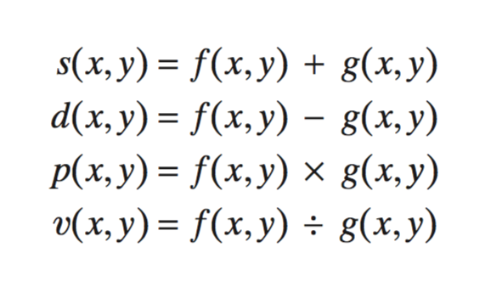
Arithmetic operations
Element-wise

Slide 40
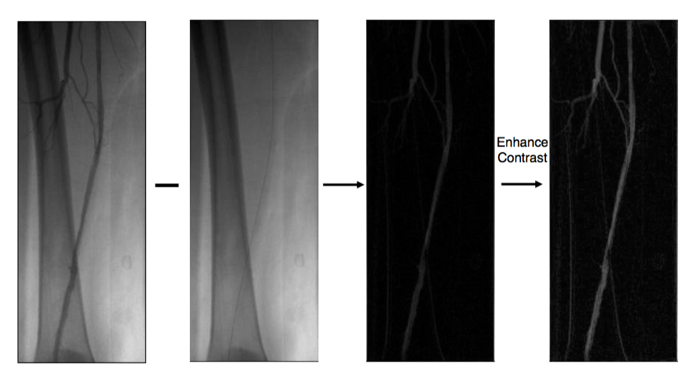
Image subtraction
Find differences between two images
Credit: Bernd Girod, CS232

Slide 41
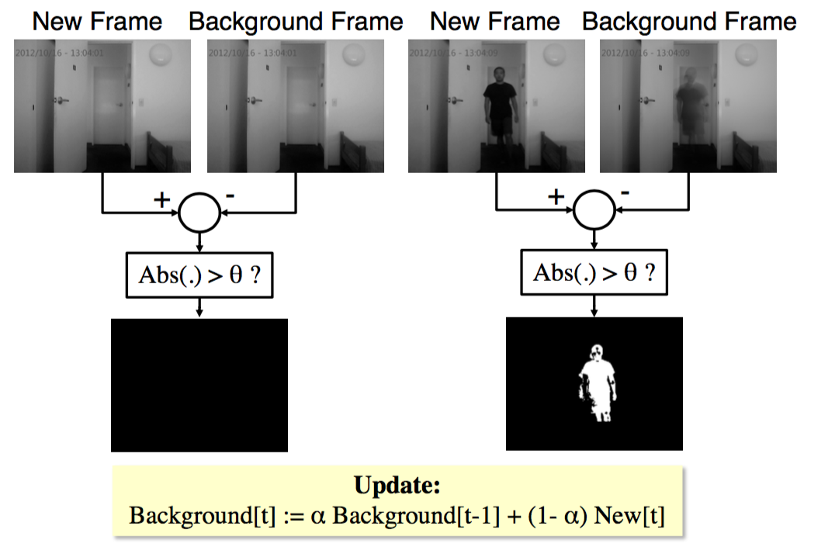
Video background subtraction
Credit: Bernd Girod, CS232

Slide 42
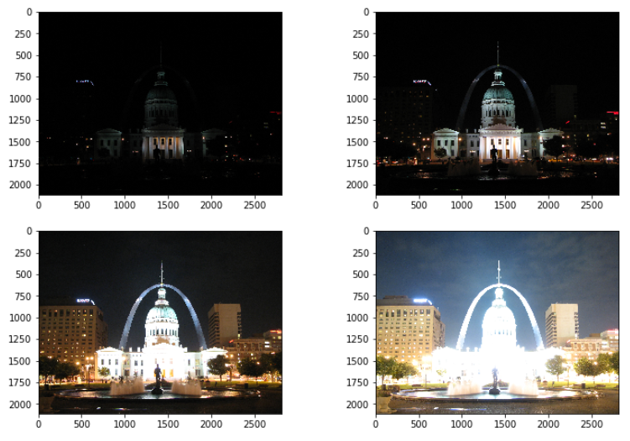
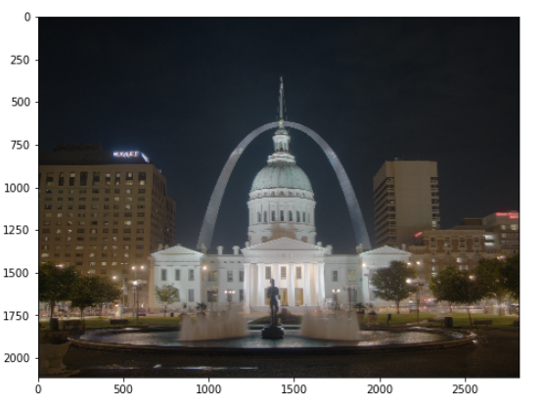
Image Averaging
Image sources: Wikipedia

Slide 43
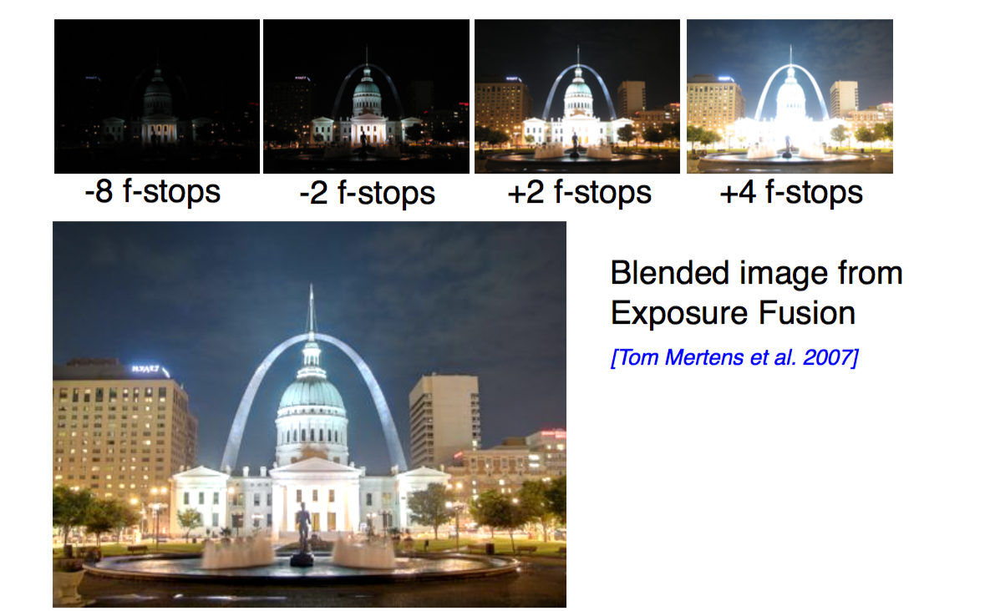
High-dynamic range imaging
Credit: Bernd Girod, CS232

Slide 44
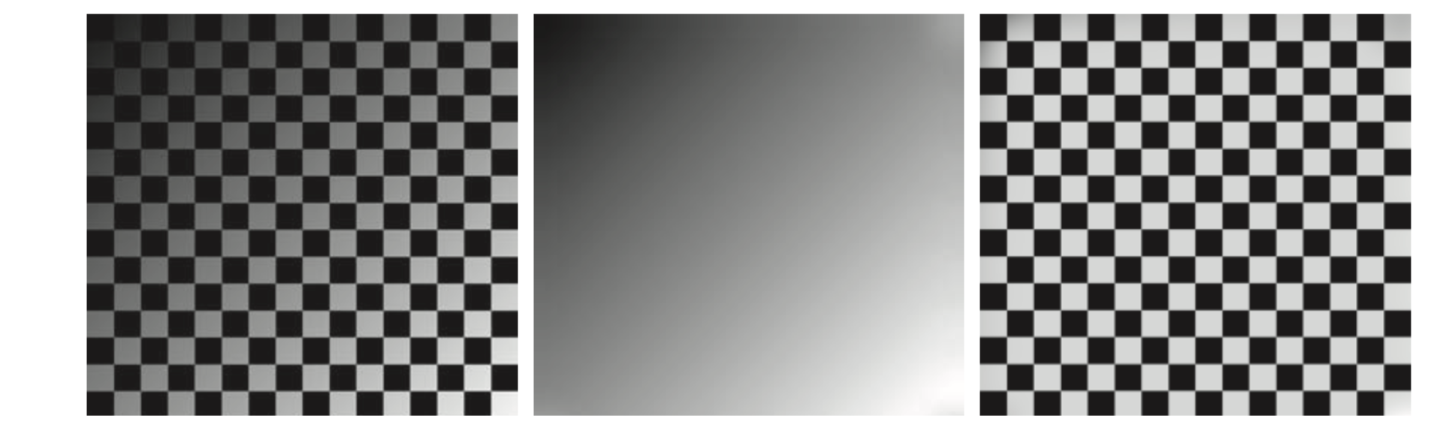
Shading correction (image division)
h: shading function
(known, or estimated)
f: “perfect image”
g: sensed image
Image credit: Gonzalez, fig. 2.33

Slide 45
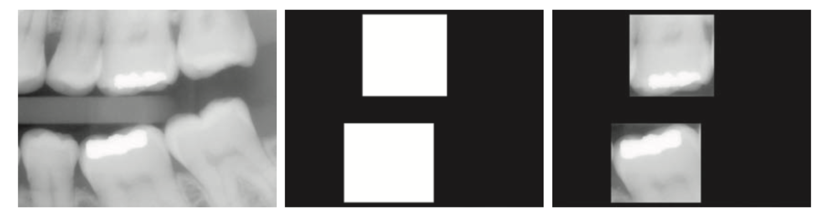
ROI masking (image multiplication)
For isolating teeth with fillings (white corresponds to 1 and black corresponds to 0)
Masking
234
234
Image credit: Gonzalez, fig. 2.34

Slide 46
Set operations

Slide 47
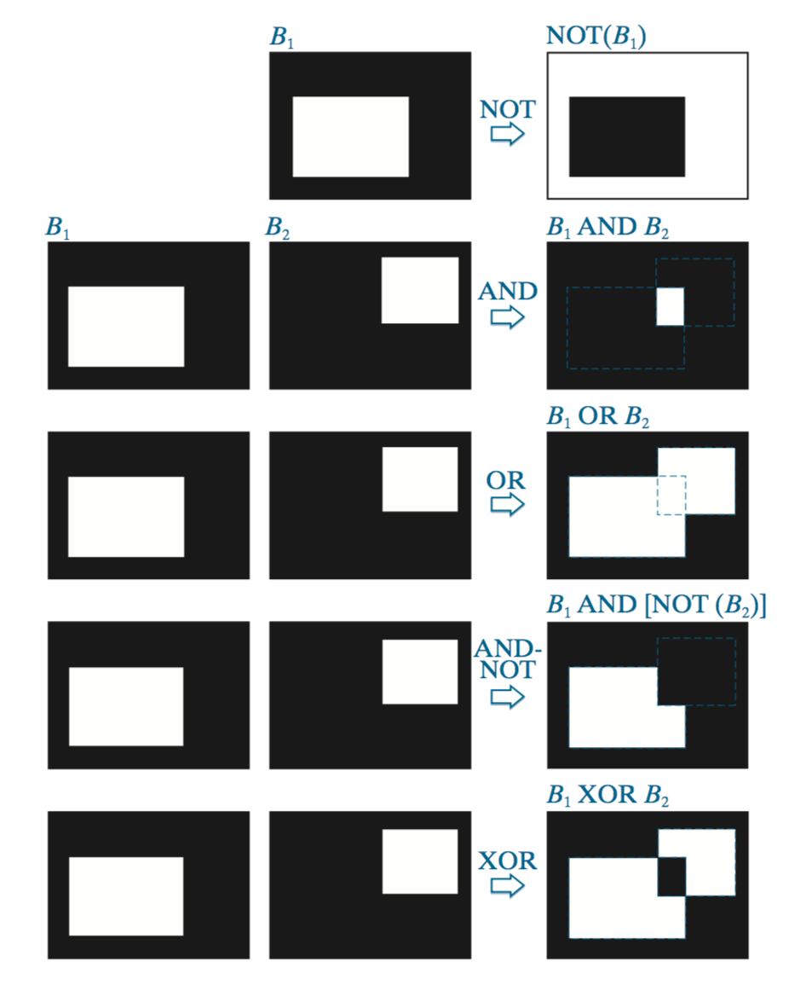
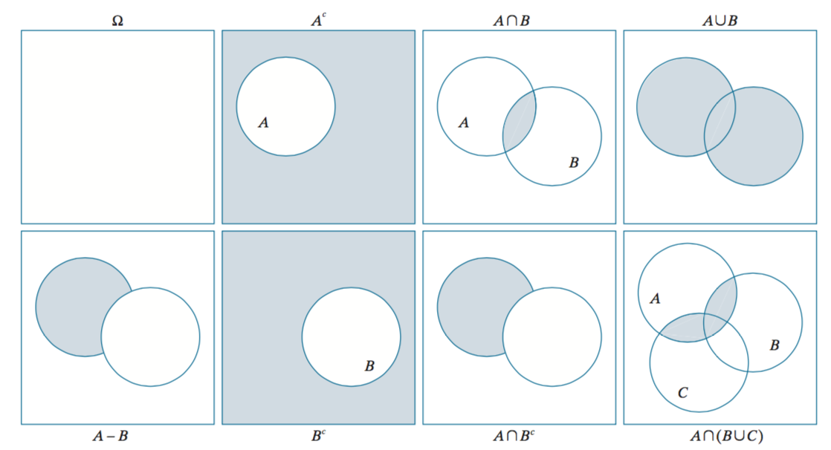
Set/Logical operations
Use set: use the coordinates of individual regions of foreground pixels in a single image as sets
Use logic: work with images of same size, and operate between corresponding pixels
Image credit: Gonzalez, fig. 2.35, 2.37

Slide 49
Homeworks
Run the code!

